Slide 1

ARDUINO BASED DESIGN: ROBOTICS

Slide 2

ROBOTICS
Design, construction, operation and application of robots
Sensors and actuators
Locomotion
Rolling : 1, 2, 4,6 etc wheels
Walking
Flying
Crawling
Climbing
Locomotion needs motor

Slide 3
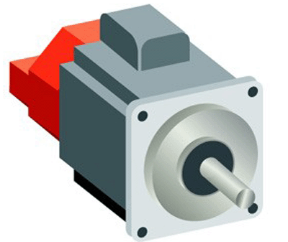
MOTORS
Electric energy to mechanical energy
Types of motors
DC motor: converts direct current electrical power into mechanical power
Stepper motor: a brushless DC electric motor that divides a full rotation into a number of equal steps
Servo motor: precise control of angular or linear position, velocity and acceleration

Slide 4
SERVO MECHANISMS

Slide 5
MOTOR DRIVER IC
Interface between microcontroller and motor
Most microprocessors operate at low voltages and require a small amount of current to operate while the motors require a relatively higher voltages and current . Thus current cannot be supplied to the motors from the microprocessor. So motor driver ICs are used.
Mostly used driver ICs
L293D
ULN

Slide 6
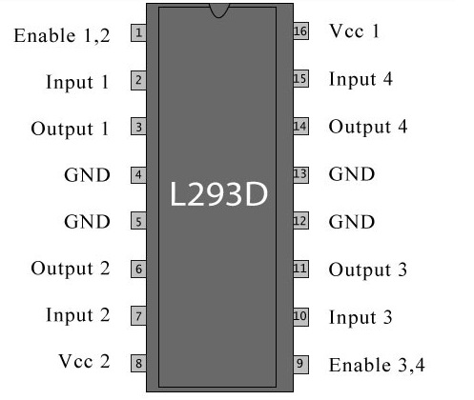
L293D
L293D Pin Diagram :
Moto driver IC from L293 series.
Consist of two H-bridge, for controlling low current rated motors.
L293D has 16 pins, they are comprised as follows: Ground Pins - 4 Input Pins - 4 Output Pins - 4 Enable pins - 2 Voltage Pins - 2

Slide 7
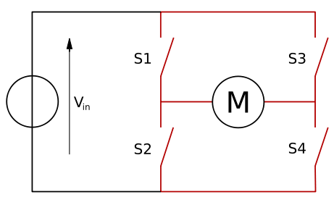
L293D
It has two voltage pins, one of which is used to draw current for the working of the L293D and the other is used to apply voltage to the motors.
There are 2 INPUT pins, 2 OUTPUT pins and 1 ENABLE pin for each motor.
H-bridge: If the switches S1 & S4 are kept in a closed position while the switches S2 & S3 are kept in a open position meaning that the circuit gets shorted across the switches S1 & S4.
The current would make the motor turn in one direction.
When the switches S2 & S3 are closed, the current flow is in counter clockwise direction.

Slide 8
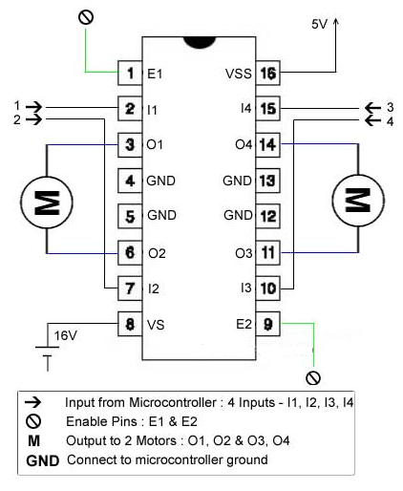
Connection
Motor has two terminals
(+ ,-) or (Vcc, 0): rotation in clockwise direction
(-, +) or (0, Vcc): rotation in anticlockwise direction

Slide 9
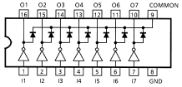
ULN2003A
The ULN2003A is an array of seven NPN Darlington transistors capable of 500mA, 50V output.
It features common-cathode flyback diodes for switching inductive loads.
A Darlington pair achieves very high current amplification by connecting two bipolar transistors in direct DC coupling so the current amplified by the first transistor is amplified further by the second one.
The seven Darlington pairs in ULN2003 can operate independently except the common cathode diodes that connect to their respective collectors.

Slide 10
TASKS
Write a program to move a two wheeled robot forward for 20 sec, wait for 10 seconds and move backward for 20 sec.
Write a program to move a two wheeled robot forward for 20 sec, turn right and then move 10 sec

